Slide 1
Avoiding Duplicate File Downloads and Forward Monitoring System in Chat App
BY ABHINAV S
BALASUNDHAR
ATHUL K

Slide 2
AGENDA
Objective
Drawbacks in existing system
Literature Survey
Proposed Project “ Avoiding Duplicate File Downloads and Forward Monitoring System in Chat App”
High level Architecture diagram
Design – Process flow and UML Diagram
Data structure Overview
Implementation
Testcase based Output Screenshot
Conclusion
Future Enhancement
References

Slide 3
OBJECTIVE
In today's fast-paced digital world, file-sharing platforms face challenges such as redundant file transfers, inefficient file tracking, and a lack of transparency in file propagation. Users often encounter issues with duplicate files, which consume storage and bandwidth unnecessarily. Additionally, administrators lack tools to monitor file-forwarding activities effectively and ensure accountability within the system.
Implement an efficient duplicate file detection mechanism to warn users when they receive a file that already exists in their local storage by leveraging SHA-256 hashing technology.
Develop a user-friendly platform that allows seamless file sharing, downloading, and forwarding while maintaining an intuitive interface for both senders and recipients.
Introduce a file-forwarding tracking system that dynamically binds sender information to the file, enabling administrators to trace the complete forwarding history and identify the users involved in the file's propagation.
Ensure real-time decision-making for duplicate files by providing users with options to cancel the download or proceed with it, based on their needs.

Slide 4
OBJECTIVE
Enable local hash storage for duplicate detection to ensure fast and accurate identification of previously received files, reducing redundancy and improving file management efficiency.
Provide robust admin tools for monitoring and control to allow administrators to analyze file-forwarding histories, ensuring transparency and accountability within the platform.
Ensure smooth integration with cloud storage services like Firebase or Cloudinary to facilitate scalable file storage, metadata management, and real-time synchronization for efficient file transfers.
Optimize user experience by simplifying the process of file selection, forwarding, and downloading while keeping the system lightweight and responsive.

Slide 5
EXISTING SYSTEM FEATURES:
Limitations in Existing Systems (WhatsApp)
No Duplicate File Detection:
Users are not warned about receiving the same file repeatedly, which can lead to unnecessary downloads and storage issues.
No Pre-Download Alerts:
Files are downloaded without prior warning about duplicates, causing potential user frustration.
No Forwarding Traceability:
The origin and forwarding chain of files cannot be tracked by admins, limiting control over file propagation.
Limited Monitoring Capabilities:
Admins lack insights into who forwarded files, making it difficult to track the spread of specific files.

Slide 6
OBSERVATIONS FROM LITERATURE SURVEY:
Lack of Duplicate File Detection: Existing systems fail to identify duplicate files efficiently, leading to redundant downloads and storage waste.
Limited File-Forwarding Monitoring: Platforms do not provide tools to trace file-sharing paths, reducing transparency and accountability.
Absence of Real-Time User Notifications: Users are not alerted about duplicate files, limiting their ability to make informed decisions.
Weak Administrative Tools: Current systems lack mechanisms for administrators to monitor file-forwarding histories effectively.

Slide 7
PROPOSED SYSTEM FEATURES:
1.File Hashing Mechanism
Generates a unique hash for each file before sending.
Hash is used to detect duplicate files efficiently.
2.Duplicate File Warning
Notifies users when a duplicate file is received.
Options provided: Cancel or Download Anyways.
3.Queue Binding for Forwarding
Tracks the forwarding path of a file by binding sender details to an existing queue.
Enables tracing all users involved in forwarding a file.
4.Admin Monitoring
Admin can view the complete forwarding history of any file.
Simplifies monitoring and auditing of file sharing activities.
5.Efficient Local Hash Storage
Stores hashes locally on the receiver’s device for faster duplicate detection.
Works even without internet connectivity.

Slide 8
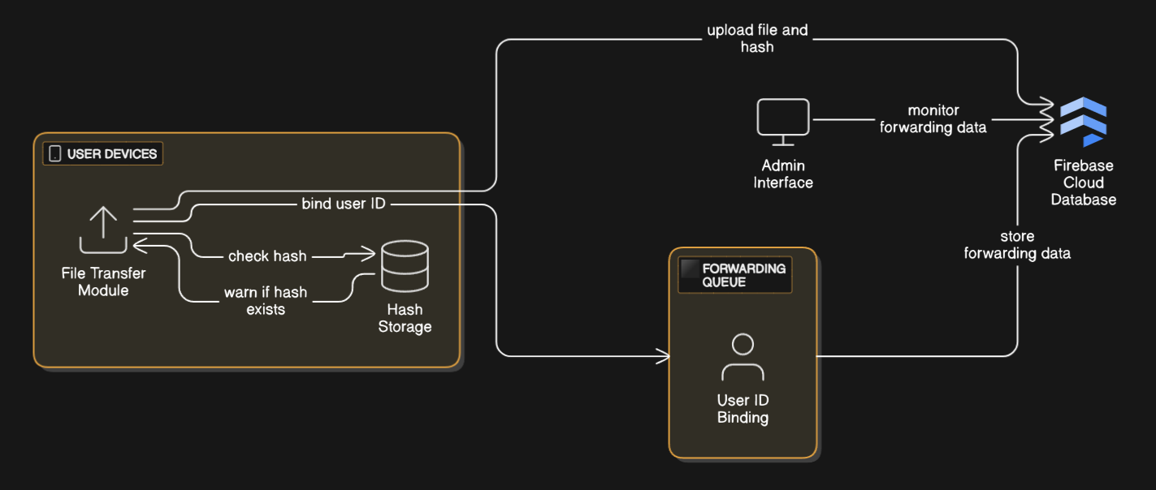
SYSTEM LEVEL ARCHITECTURE DIAGRAM:
Fig 1.1 High Level Architecture

Slide 9
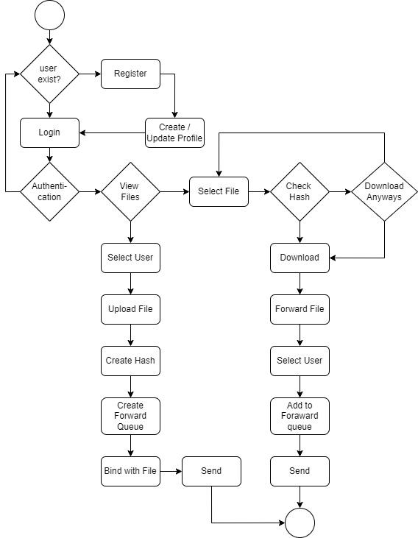
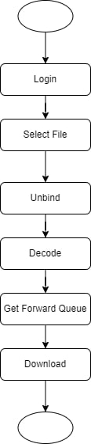
DESIGN – PROCESS FLOW & UML DIAGRAM
Fig 1.2 Process Flow Diagram

Slide 10
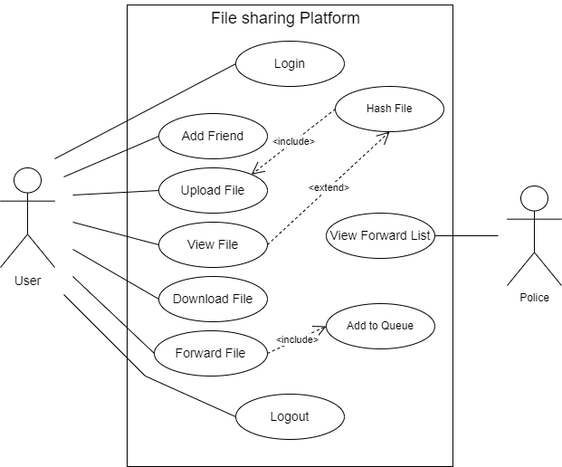
DESIGN – PROCESS FLOW & UML DIAGRAM CONT..
Fig 1.3 Usecase Diagram

Slide 11
DATA STRUCTURES OVERVIEW:
File Metadata Management: Hash Tables are used to store file metadata (e.g., name, size, hash value) for efficient retrieval and duplicate detection.
Duplicate File Detection: Hash Functions (SHA-256) generate unique file hashes to identify duplicates by comparing them with stored hashes in local storage.
File Forwarding Tracking: Queues manage the file propagation path, while Linked Lists link users sequentially to track transfer history.
Notification System: Priority Queues ensure timely duplicate warnings and forwarding alerts based on priority levels.
File Propagation Monitoring: Graphs represent file-sharing networks, enabling admins to trace forwarding paths efficiently.

Slide 12
IMPLEMENTATION:
Modules Description
Chat-file Transfer Module: Platform for Transferring files .
Duplicate Detection Module: Alerts users if the file hash already exists locally.
Queue Management Module: Tracks file forwarding history.
Admin Monitoring Module: Allows admins to trace the forwarding path of files.
Software Requirements:
Database: SQLite
Framework: Android SDK
Hardware Requirements:
Device: Android smartphone
Connectivity: WiFi or Bluetooth for file transfer

Slide 13
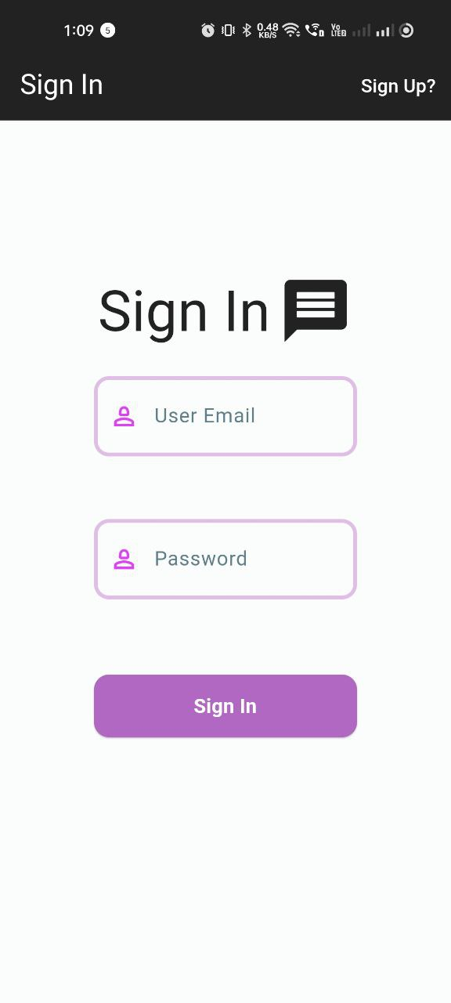
TEST CASE BASED OUTPUT SCREENSHOTS
Login
Verifies that users can successfully log in with valid credentials and are redirected to the home page. Ensures proper error handling for invalid login attempts, such as incorrect email or password.

Slide 14
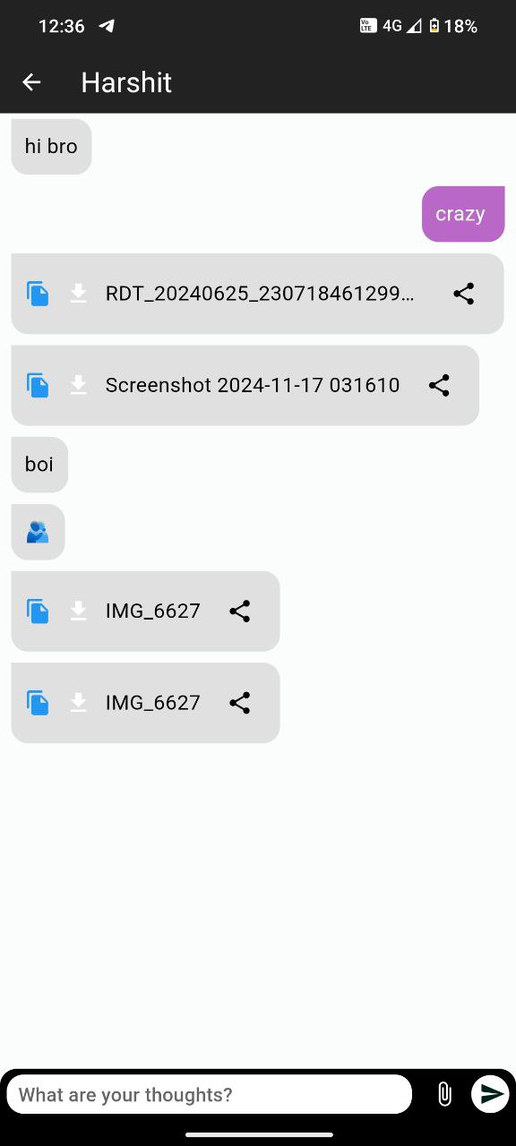
TEST CASE BASED OUTPUT SCREENSHOTS
2. Uploading a File
Tests whether users can upload files successfully and ensure the file metadata (e.g., file name, hash, size) is correctly stored in the database.

Slide 15
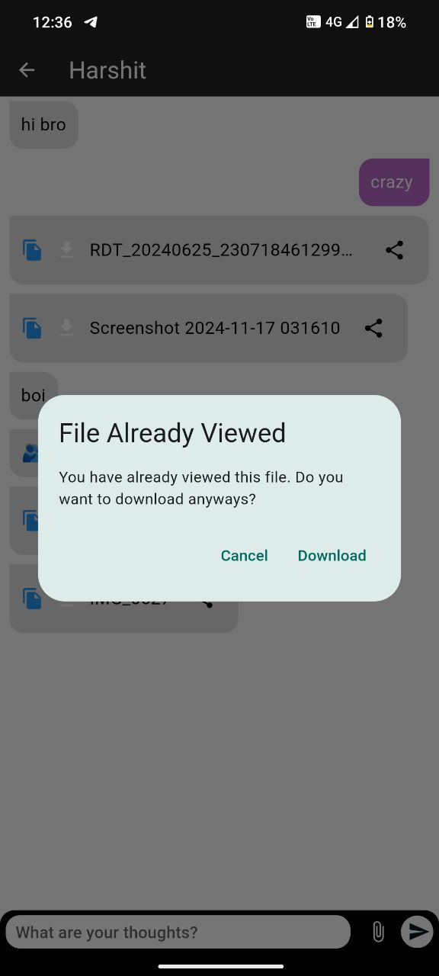
TEST CASE BASED OUTPUT SCREENSHOTS
3. Detecting Duplicate Files
Confirms that the system identifies duplicate files by comparing their hash values with previously stored hashes in the receiver's local storage. Ensures that a warning is displayed to the user, offering options to Cancel the download or Download Anyway.

Slide 16
Understanding Hash Collisions
Hash functions like SHA-256 generate a fixed-size hash (256-bit for SHA-256) regardless of the size of the input file.
Since the possible number of inputs is infinite (all files of all sizes) and the output is finite (fixed-size 256-bit hash), collisions are theoretically unavoidable.
Even a single bit change in the content will result in complete different hash due to avalanche effect.
However, SHA-256 is cryptographically designed to make collisions extremely rare, to the point where it is practically infeasible.

Slide 17
Chances of Hash Collisions
Probability: The chances of two different files randomly producing the same SHA-256 hash are astronomically small.
SHA-256 provides 2^256 possible hash values (about 10^77 combinations).
To put this into perspective, the universe is estimated to have 10^80 atoms, so the chance of a collision happening is almost negligible.
2. Real-World Likelihood:
For two files to produce the same hash, they would need to be crafted specifically to exploit weaknesses in the hash function.
As of now, no practical method exists to generate SHA-256 collisions intentionally, unlike older algorithms like MD5 or SHA-1, which have been broken.

Slide 18
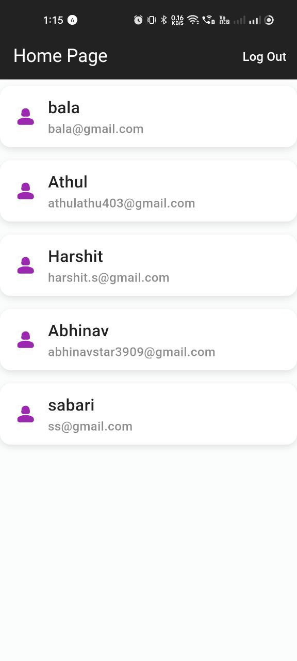
TEST CASE BASED OUTPUT SCREENSHOTS
4. Forwarding a File
Tests whether users can forward a file to other users. Ensures that the forwarding queue is updated with the sender’s user ID, and the file’s forwarding history is logged accurately.

Slide 19
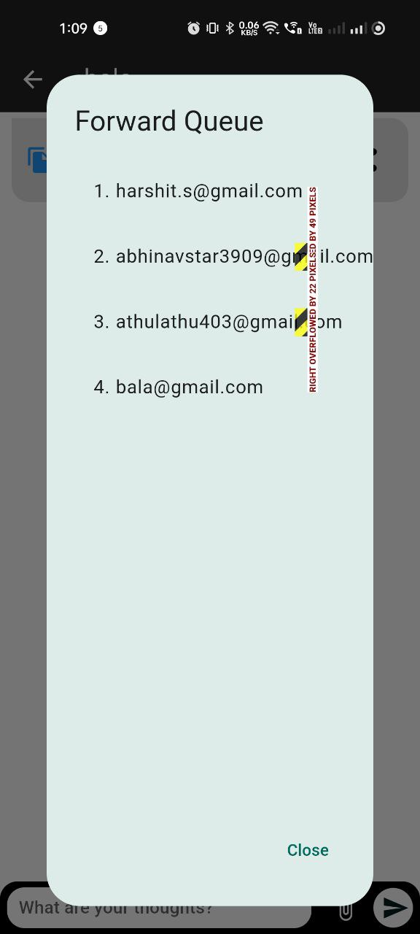
TEST CASE BASED OUTPUT SCREENSHOTS
5. Admin Dashboard - View File Forwarding History
Confirms that administrators can view the complete forwarding history of a file, including details such as user IDs and timestamps of forwarding events.

Slide 20
CONCLUSION:
Successfully implemented a file-sharing platform that prevents redundant downloads through hash-based file verification.
Enhances user experience by providing real-time duplicate warnings with actionable options like "Cancel" or "Download Anyway."
Introduced sender tracking and queue binding, enabling efficient file forwarding monitoring for admin-level insights.
Paves the way for future enhancements, such as advanced security measures and scalability for larger networks.

Slide 21
FUTURE ENHANCEMENT:
1. Advanced File Encryption:
Implement end-to-end encryption for file transfers to enhance data security and prevent unauthorized access.
2. Multi-Device Hash Synchronization:
Introduce synchronization across multiple devices for users, ensuring hash data is consistent and accessible on all logged-in devices.
3. Detailed Analytics for Admins:
Provide comprehensive analytics for administrators, such as file-sharing trends, most forwarded files, and user activity summaries.
4. Enhanced Forwarding Visualization:
Develop a graphical representation of file-forwarding routes for administrators, making it easier to identify patterns or anomalies in file-sharing activities.
5. Support for Larger File Sizes:
Optimize file handling mechanisms to support larger file uploads and downloads without impacting performance.

Slide 22
REFERENCES:
[1] A. Miller, J. Davis, and K. Harris, "Hash-based duplicate detection in file-sharing systems," Journal of Information Systems and Technology, vol. 29, no. 4, pp. 231-244, 2017.
[2] P. Kumar and S. Joshi, "Enhancing user decision-making through actionable notifications," International Journal of Human-Computer Interaction, vol. 33, no. 2, pp. 89-104, 2019.
[3] H. Zhang, Y. Liu, and M. Edwards, "Efficient queue-based architectures for metadata management in distributed systems," Journal of Distributed Computing Systems, vol. 15, no. 3, pp. 101-119, 2020.
[4] T. Smith, R. Green, and L. Adams, "The role of local storage in enhancing user-centric file management systems," Journal of Computer Applications and Innovations, vol. 22, no. 1, pp. 45-59, 2018.
[5] W. Li and J. Wong, "Tracing file propagation: A tool for ensuring accountability in file-sharing platforms," IEEE Transactions on Network and Systems Management, vol. 12, no. 5, pp. 322-330, 2019.
www.geeksforgeeks.org

